Slide 1
Criminalization costs in the EECA countries: what repressive drug policy costs for the societies?
Eliza Kurcevic, Ganna Dovbakh,
Eurasian harm reduction Association

Slide 2
Key questions
There no spare money for harm reduction services. Isn't it?
Data on criminalization costs and arguments build on it
EHRA drug policy web
Notes:
I do not want preaching to the convert. If you are here in harm reduction conference, it mean that you know about efficiency of

Slide 3
Criminalization costs method
Data collected and verified by EHRA members – civil society and PUD community
Open documents/official reports is the main information source
Requests for financial information from governmental
Verification/triangulation of data from different sources by community members
No data – means that community and civil society have no access to information about cost of the programs or expenditures.

Slide 5
map

Slide 7
3
17
5
4
16
7
4
9
Notes:
When we started this assessment, I thought that is states spend 2-3 times more on prison then on supporting person in freedom, it is impressive. Now you could see what is impressive.
17 people could get full package of harm reduction services instead of keeping one f them in prison. 16 times more spend in Croatia.
9 times more is spend for harm reduction in comparison to prison in Bulgaria. I should not say spent – it was spent by Global Fund for this till the mid of 2018. since summer of 2018 all programs of needle exchange in Bulgaria are closed. There is only OST left.

Slide 8
2
3
2
10

Slide 9
Lithuania: waisted lives and 25 mln
Because of recent criminalization of drug possession in Lithuania, registered crimes of the possession of drugs raised in 2018 by 17,7% (even till sept):
In 2017 m. - 1959
In 2018 m. (January - September) – 2305
In 2017, 755 people were in prison for the drug possession in Lithuanian prisons. Average sentence for such crime, given by the court is 8 years and the real sentence is 4 years. One day costs 23,31 Eur./ per day/ per prisoner so for one year it’s 8508 Eur. Investigation and court expenditures are not included, as well as lost incomes and taxes for this period.
Calculation: 755 people*8508 Eur. (prison costs)*4 years = 25 694 160,00 Euro
We’ll see if this argument against criminalization of drugs possession will work during Lithuanian Parliament discussion next week.

Slide 10
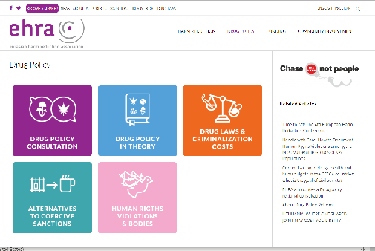
EHRA resource webpage
https://harmreductioneurasia.org/drug-policy/

